Slide 1
Consumer Demand
Microeconomics: Chapter 1

Slide 2
Microeconomics
Definition: the branch of economics that studies the behavior of individual consumers, firms, and government entities and their roles in answering the fundamental questions of WHAT, HOW, and FOR WHOM to produce

Slide 3
Key Questions of Consumer Demand
How do we decide how much of a particular good/service to buy?
How does the change in a product’s price affect the quantity we purchase or the amount of money we spend on it?
What factors other than price affect our consumption decisions?

Slide 4
Patterns of Consumption
Figure 4.1 (pg. 83)
How essential is spending on basic essentials?

Slide 5
Quick Refresh: Market Demand
Definition:
Total quantities of a good or service that the consumers in a market are willing and able to buy at alternative prices; the sum of all individual demands
Determinants:
Tastes (desire for this & other goods)
Income (of consumers)
Expectations (for income, prices, and tastes)
Other Goods (availability and price)
Number of consumers in market

Slide 6
Shaping the Demand Curve: Utility Theory
Definition of UTILITY:
Total utility
The amount of satisfaction obtained from the entire consumption of a good or service
Marginal Utility
The satisfaction gained by consuming one additional unit of a good or service

Slide 7
Diminishing Marginal Utility
Law of Diminishing Marginal Utility
e.g. declining utility of pizza

Slide 8
Practice Problems: Utility Theory
Page 100: problems 7 & 8

Slide 9
Shaping the Demand Curve: Price & Quantity
DMU & the downward-sloping demand curve
Each additional unit consumed decreases in utility, THUS:
The great number of units consumed, the less one is willing to pay for additional units.

Slide 10
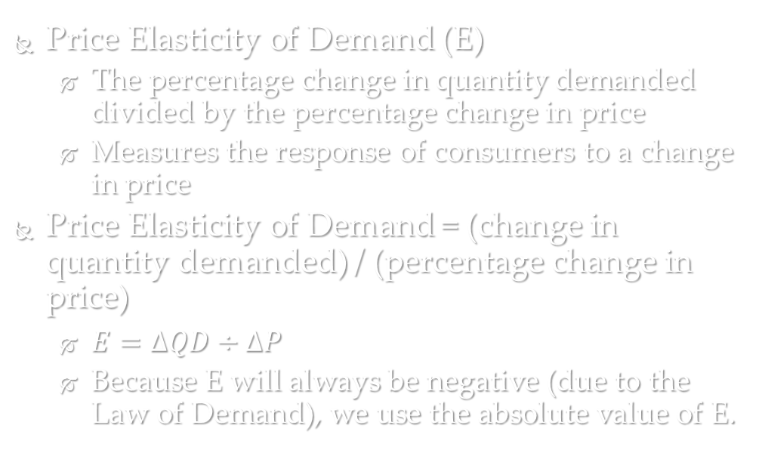
Price Elasticity of Demand
Price Elasticity of Demand (E)
The percentage change in quantity demanded divided by the percentage change in price
Measures the response of consumers to a change in price
Price Elasticity of Demand = (change in quantity demanded) / (percentage change in price)
$E=∆QD÷∆P$
Because E will always be negative (due to the Law of Demand), we use the absolute value of E.

Slide 11
Elastic vs. Inelastic Demand
Relatively Elastic
$E>1$
If demand is relatively elastic, consumers are VERY responsive to changes in price.
Relatively Inelastic
$E<1$
If demand is relatively inelastic, consumers are NOT very responsive to changes in price.
Unitary Elastic
$E=1$
If demand is unitary elastic, consumers respond to changes in in price with proportional changes in quantity demanded.

Slide 12
Price Elasticity and Total Revenue
Total revenue: the amount of money received by the supplier from product sales
$Total Revenue=price×quantity sold$

Slide 13
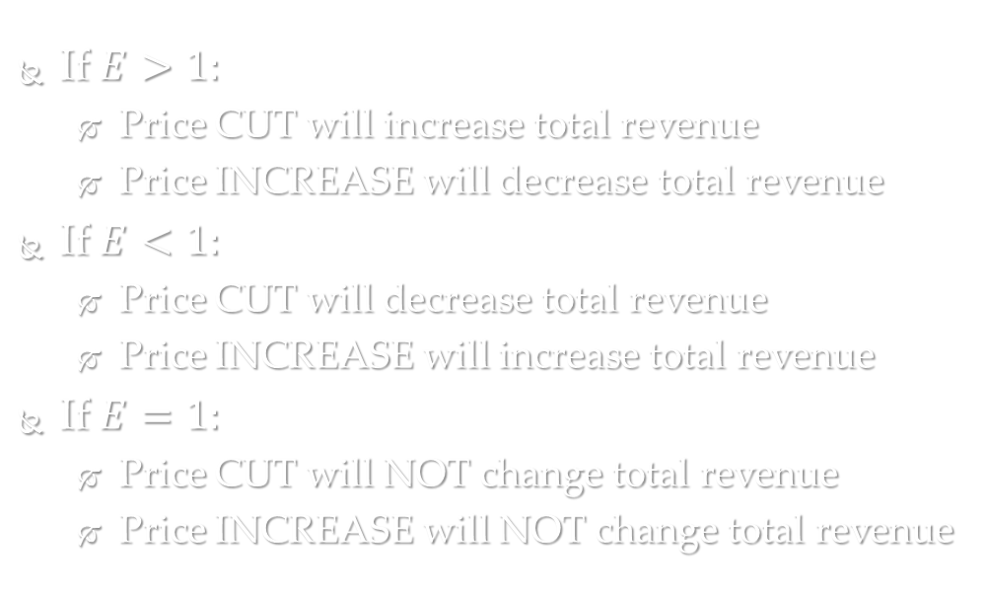
Price Changes and Elasticity
If $E>1:$
Price CUT will increase total revenue
Price INCREASE will decrease total revenue
If $E<1:$
Price CUT will decrease total revenue
Price INCREASE will increase total revenue
If $E=1:$
Price CUT will NOT change total revenue
Price INCREASE will NOT change total revenue

Slide 14
Determinants of Price Elasticity
Necessities vs. Luxuries
Demand for necessity goods is relatively inelastic
Demand for luxury goods is relatively elastic
Availability of Substitutes
The greater the availability of substitutes, the more elastic the good’s demand
Price Relative to Income
The greater percentage of income a good represents, the more elastic the demand

